Slide 1
MongoDB CRUD Operations
Group – 05
Section - 02
Naga Anshitha Velagapudi

Slide 2
CRUD Operations
Create Operations
Read Operations
Update Operations
Delete Operations
Bulk Write

Slide 3
Create Operations
Create Operation will either create or insert new documents into a collection.
If a collection is not available, then insert operation will create a new collection
For inserting one document –
Method - db.collection.insertOne()
For inserting many documents –
Method - db.collecting.insertMany()

Slide 4
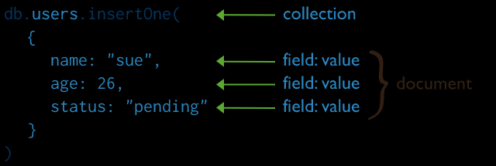

Slide 5
Read Operations
Read operation will retrieve documents from given collection.
Method – db.collection.find()

Slide 6
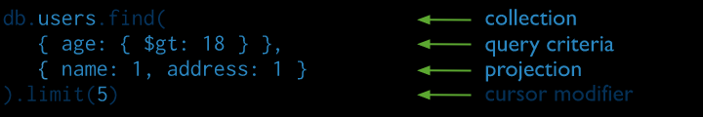

Slide 7
Update Operations
Update Operation will modify the document which is already inserted in collection
For updating one document
Method – db.collection.updateOne()
For updating many documents
Method – db.collection.updateMany()
For replacing a document
Method – db.collection.replaceOne()

Slide 8
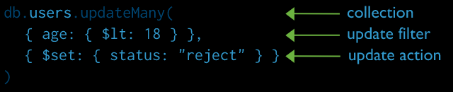

Slide 9
Delete Operations
Delete Operation will delete documents from given collection or selected item/field.
For deleting one document
Method – db.collection.deleteOne()
For deleting many documents
Method – db.collection.deleteMany()

Slide 10
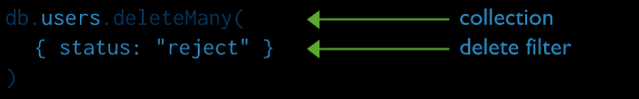

Slide 11
Bulk Operations
In Bulk Operations, we can perform any operations in bulk i.e. many at the same time
Method – db.collection.bulkWrite()
This bulkWrite() can be ordered or unordered but performs ordered by default.
When ordered – MongoDB executes serially.
If error occurs, it will return without executing next operations in the queue.
When Unordered – It executes parallel and even if error occurred, it will continue to process remaining operations.

Slide 12
bulkWrite() is used with following operations
insertOne
updateOne
updateMany
replaceOne
deleteOne
deleteMany

